Slide 1



TIME VALUE OF MONEY

Slide 2

After studying this chapter, you should
be able to understand:
What is Time Value of Money
Method / Types of Interest
Cash flow Diagram
Types of Compound Interest Formulas.
L E A R N I N G O B J E C T I V E S

Slide 3




Decision Dilemma—Take a Lump Sum or Annual Installments
A suburban Chicago couple won the Power-ball.
They had to choose between a single lump sum $104 million, or $185 million paid out over 25 years (or $7.92 million per year).
The winning couple opted for the lump sum.
Did they make the right choice? What basis do we make such an economic comparison?

Slide 4


Why Do We Need to Know?
To make such comparisons (the lottery decision problem), we must be able to compare the value of money at different point in time.

Slide 5

Time Value of Money
Money has a time value because it can earn more money over time
Money has a time value because its purchasing power changes over time
Time value of money is measured in terms of interest rate.
Interest is the cost of money—a cost to the borrower and an earning to the lender.

Slide 6
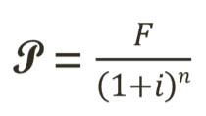

Types of Interest
Simple Interest ; I= P *n * i
Compound Interest ; F = P(1+i)^{n} or

Slide 7
Method for calculating Simple Interest
The practice of charging an interest rate only to an initial sum (principal amount).
In this case interest earned is directly proportional to capital involved in the loan.
If, I= interest earned through several time period.
P= Principal amount, i= rate of interest per period
N= number of interest periods (usually years)
Then, I= P * i *N
The total amount the borrower is supposed to pay the lender,
F= P + I => P + PiN => F = P(1+ iN)

Slide 8

Method for calculating Compound Interest
The practice of charging an interest rate to an initial sum and to any previously accumulated interest that has not been withdrawn.
Total amount to pay, varies drastically when compared to simple interest charged.
F= P . (1 + i)^{n}
P- Principal Amount invested at time 0,
F- Future amount,
i- interest rate compounded annually,
n- period of deposits

Slide 9
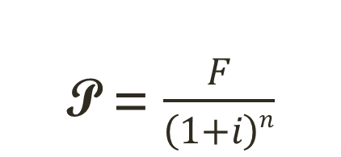
Method for calculating Compound Interest
Alternatively,
  If we want 100 Rs at the end of n^{th} year what should be the amount deposited now?
Similarly, there are different interest formulas which are very useful for making investment decisions
P- Principal Amount invested at time 0,
F- Future amount, i- interest rate compounded annually, n- period of deposits

Slide 10
Cash Flow Diagram
Cash flow diagrams are the simple representation of income and outlay.
Generally before constructing the diagram it is very common to define the time frame over which cash flow occurs.
The time frame thus forms the horizontal axis which is divided into time periods, often in years.
0
i%
10

Slide 11
Cash Flow Diagram
(a) Borrower’s viewpoint
Loan in Rs
+
1
2
3
time
-
0
10
Payment (expenditures)
Rs
Rs
Rs
(b) Lender’s viewpoint
Rs
Rs
Rs
Payment (receipt)
+
0
time
-
i%
10
Loan in Rs

Slide 12
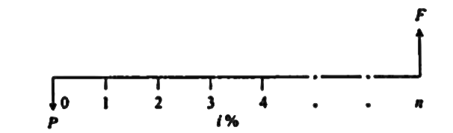
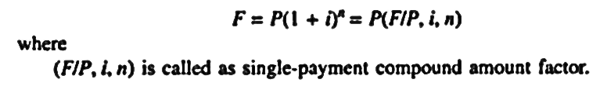
Types of Compound Interest Formulas
1. Single payment compound amount:
Here the objective is to find the single future sum (F) of initial payment P after n period at interest rate i % compounded every period.

Slide 13
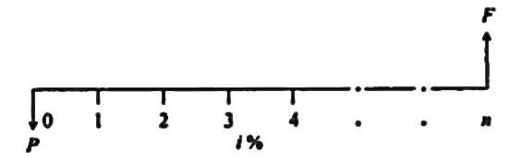
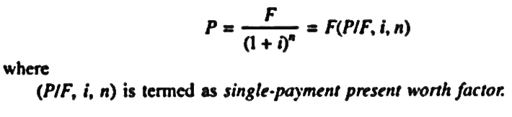
Types of Compound Interest Formulas
2. Single Payment Present Worth Amount:
Here the objective is to find the present worth amount (P) of a single future sum (F) which will be received after n periods at an interest rate of i% compounded at the end of every interest period.

Slide 14
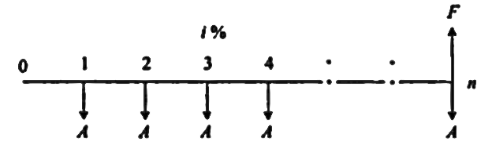
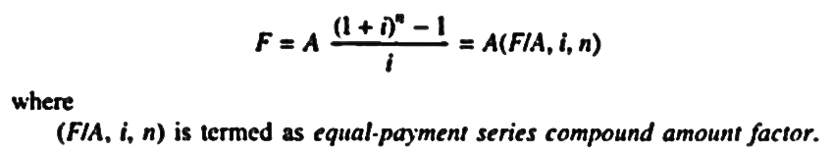
Types of Compound Interest Formulas
3. Equal Payment Series Compound Amount:
Here the objective is to find the future worth of n equal payments which are made at the end of every interest period till the end of nth interest period at an interest rate of i % compounded at the end of each interest period.

Slide 15
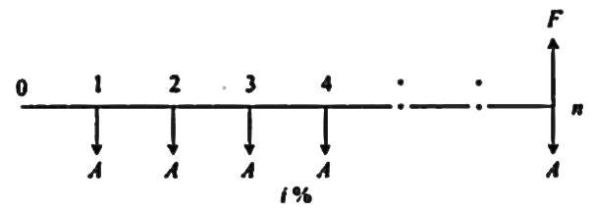
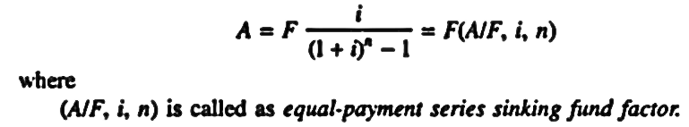
Types of Compound Interest Formulas
4. Equal Payment Series Sinking Fund:
Here the objective is to find the equal amount (A) that should be deposited at the end of every interest period for n period to realize a future sum (F) at the end of nth period at an interest rate of i %.

Slide 16
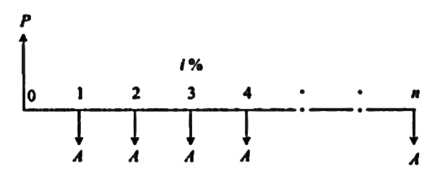
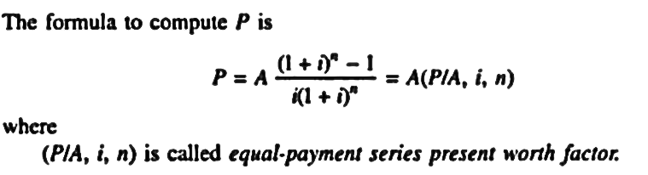
Types of Compound Interest Formulas
5. Equal Payment Series Present Worth:
Objective is to the find present worth of an equal payment made at end of every interest period for n periods.

Slide 17
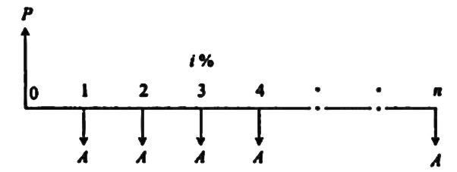
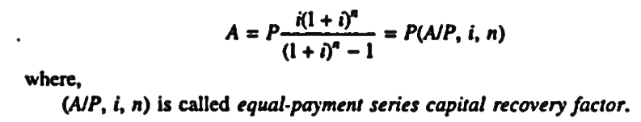
Types of Compound Interest Formulas
6. Equal Payment Series Capital Recovery Amount:
Objective of this mode of investment is to find the annual equivalent amount (A) which is to be recovered at the end of every interest period for n interest periods for a loan (P) which is sanctioned now at an interest rate i% compounded every period.

Slide 18
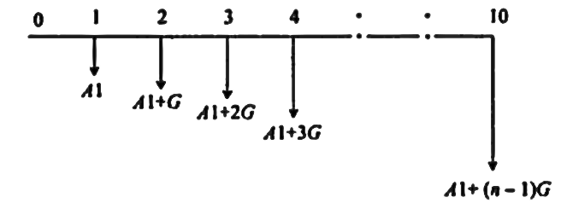
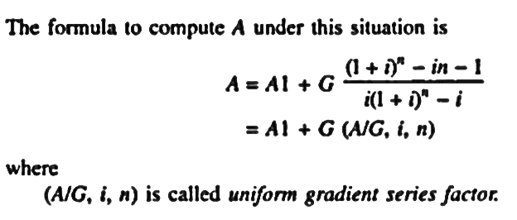
Types of Compound Interest Formulas
7. Uniform Gradient Series Annual Equivalent Amount:
The objective of this mode of investment is to find the annual equivalent mode of a series with an amount A₁ at the end of first year and with an equal increment (G) at the end of each of the following n-1 years with the interest rate i % compounded annually.

Slide 19
Solved Problems
If Mr. X deposits Rs.1000 in his bank account at 6% compounded interest on January 1, 2001. How much money will be accumulated on January 1, 2011 ?
Determine the amount P that you should deposit into an account 2 years from now, in order to be able to withdraw Rs. 4000/- per year for 5 years starting 3 years from now, at an interest rate of 15% per year ?
A company is planning to make two equal deposits such that 10 years from now the company will have $ 49000 to replace a small machine. If the first deposit is to be made 1 year from now and the second is to be made 9 years from now, how much must be deposited each time if the interest rate is 15% per annum ?

Slide 20
Solved Problems
Determine the future amount of Rs. 100/- payment deposited at the end of each of the next five years and earning 6% per annum.
It is desired to accumulate Rs. 563.70 by making a series of 5 equal annual payments at 6% interest compounded annually. What is the required amount of each payment?
Rs. 1000/- invested now at 5% interest compounded annually, provide for 8 equal future year end payments. Determine A.
A professor working in MSRIT has 10 years of service before he retires. He now plans to deposit Rs. 25000 at the end of first year and there after an annual increase of Rs. 500 for the remaining nine years. If he can expect a return of 10% find the future amount at the end of the 10th year.

Slide 21
Solved Problems
8. Arun buys a car, making an initial payment of Rs. 1,00,000/- and taking a loan of Rs. 1,50,000 from ICFC Bank. He makes equal monthly repayments of Rs.8000 to ICFC Bank, to clear the loan in full for a period of 2 years. After making the last payment, he sells the car for Rs. 1,50,000. Draw two CFD’s one for Arun and one for ICFC Bank for the above cash flow.

Slide 22

Recap
What is Time Value of Money
Method / Types of Interest
Cash flow Diagram
Types of Compound Interest Formulas.

